Slide 1
Welcome to Nile Class!
Miss Munro
Mrs Mowbray
Mrs Hall

Slide 2
Classroom Schedule
Timing | Activity
8:45 - 9:05 | School starts, Morning Task, Register
9:05 - 9:45 | Guided Reading
9:45 - 10:40 | Morning Break
11:00 - 12:00 | Maths
12:00 - 1:00 | Lunch Break
1:00 – 1:15 | Handwriting or class reader
1:15 - 2:10 | History
2:10 - 3:00 | Science
3:00 - 3:15 | Assembly or class assembly
3:15 - 3:20 | End of day routine
3:20 | School ends
This is what a typical day in our classroom looks like.

Slide 3
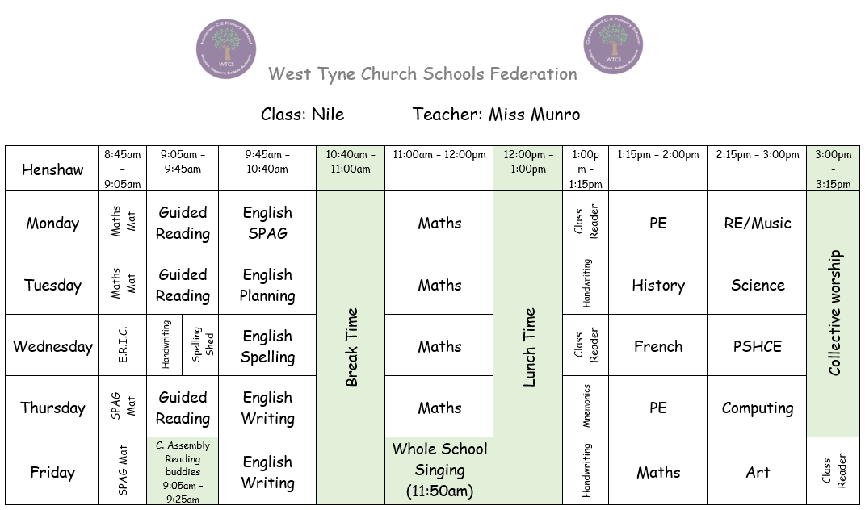

Slide 4
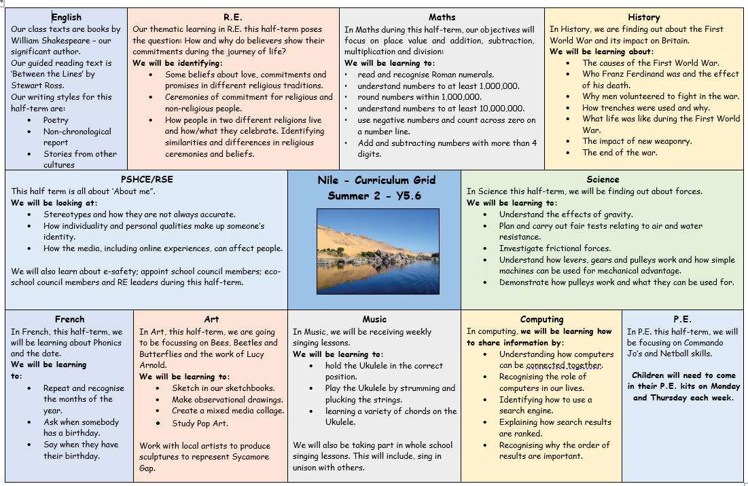

Slide 5
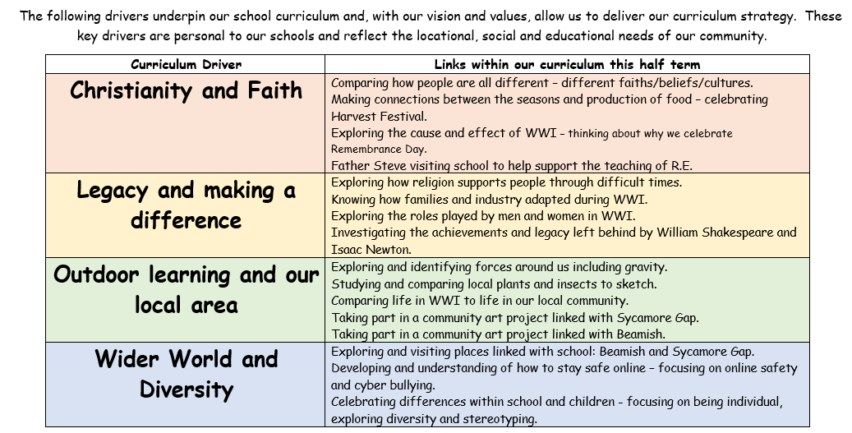

Slide 6
Reading

Slide 7
Homework

Slide 8
P.E. Days
Monday
Thursday
Please come to school in P.E. kit.
No jewellery.

Slide 9
Communication
Class email (Gold cards/homework)
School Facebook page
Phone calls
Letters and contact from Mrs Slater
Home/school diary (spellings & reading)

Slide 10
Upcoming events
Art project linked with Sycamore Gap
Trip to Beamish
Harvest Festival
Termly homework
Christmas Production

Slide 11
Thank you

Slide 12
Any questions?

