Slide 1
Welcome to our phonics and reading information sharing session 21.06.22

Slide 2
Phonics and Early Reading
Part 1 – information about how we teach phonics.
Part 2 – information about how we teach reading.
Part 3 – supporting at home.

Slide 3
What is phonics?
Phonics is a way of teaching children how to read and write.
It helps children hear, identify and use different sounds that distinguish one word from another in the English language.

Slide 4
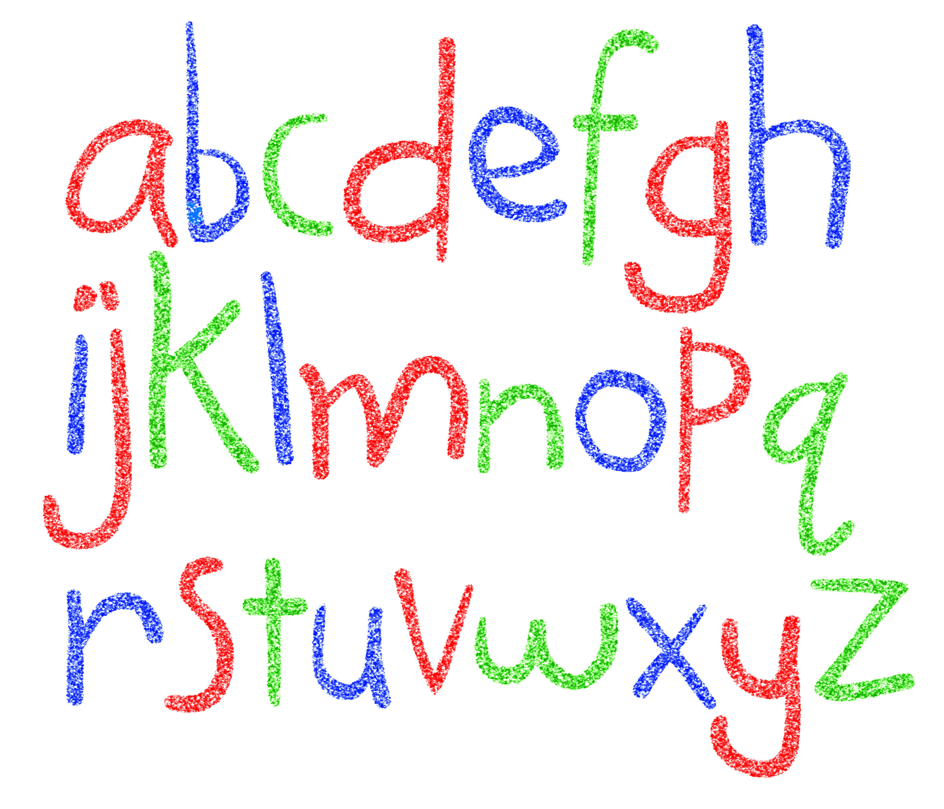
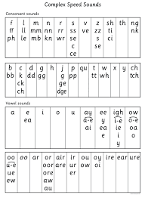
Did you know?
The English language has:-
26 letters
44 sounds
Over 100 different ways
to spell those sounds.

Slide 5
New DFE Guidance for Early Reading and Phonics
The journey to independent reading and writing begins with Phonics
www.ruthmiskin.com
Why Read Write Inc?
RWI is a systematic synthetic phonics programme (DfE accredited).
Excellent training for all staff to ensure consistency.
Every aspect of phonics and reading included in a detailed, thorough and systematic approach.
Engaging resources.
Using RWI, the children learn to read effortlessly so that they can put all their energy into comprehending what they read. It also supports their spelling so that they can put all their energy into composing what they write.
Comprehensive system for identifying and supporting children requiring extra help.
Useful support for parents.
Notes:
Government changes mean a change (for the better) in how we teach phonics and reading at school - make sure there is consistency throughout
Early reading is the stage where children are learning to become fluent readers through the use of phonics

Slide 6
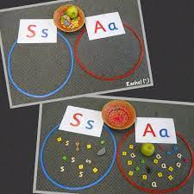
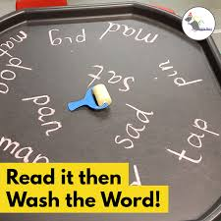
How we teach phonics
Early phonics skills
Daily sessions
Specific order of teaching
Synthetic phonics – phonemes/graphemes
Correct pronunciation is vital
Repeated practice: revisit previously taught sounds at
start of each lesson.
m-u-s-t

Slide 7
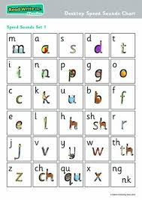
Notes:
Phonemes taught in order start to read words asap
LW has a picture pneumonic to help children remember the phoneme/grapheme

Slide 8
Make it fun! Practise forming letters in steam on shower, using baths chalks, jumbo chalks outside, shaving foam… Play ‘I Spy’, find something beginning with…

Slide 9
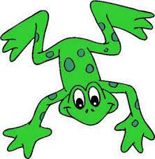
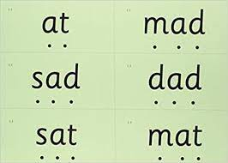
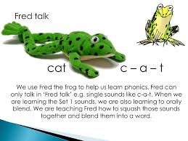
Notes:
Early digraphs mostly consonant digraphs – 2 letters 1 sound

Slide 10
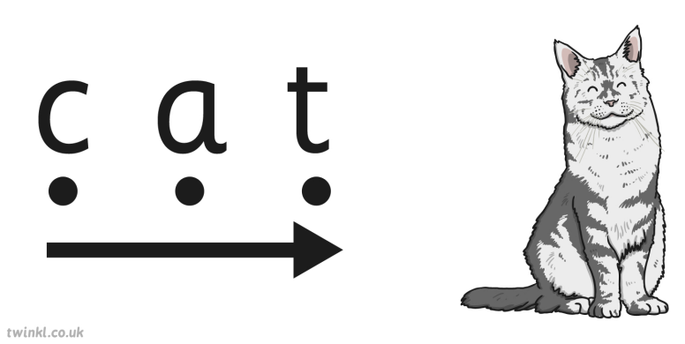
In the word ‘cat’, children will be able to identify three individual phonemes separately using the synthetic method. If we separate the word into single phonemes, we end up with the sounds /k/, /a/ and /t/. We can then blend those sounds back together again to produce the word ‘cat’.
The word ‘cat’ is an example of a CVC word, which is a word that contains a consonant sound, a vowel sound in the middle and finally another consonant sound at the end.

Slide 11
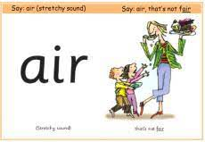
Meaning of words
you may hear your children say….
-phonics – The teaching of reading by developing awareness of the sounds in words and the corresponding letters used to represent those sounds.
phoneme - Any one of the 44 sounds which make up words in the English language.
grapheme – How a phoneme is written down. There can be more than one way to spell a phoneme, e.g.-the phoneme ‘ay’ is spelt differently in each of the words ‘way’, ‘make’, ‘fail’, ‘great’, ‘sleigh’ and ‘lady’.
segmenting – Breaking a word into sounds in order to spell
them, e.g. ‘frog, f – r – o – g’’
blending – Putting together the sounds in a word in order to read it, e.g. ‘f – r – o – g, frog’
digraph- 2 letters making one sound
trigraph- 3 letters making one sound

Slide 12
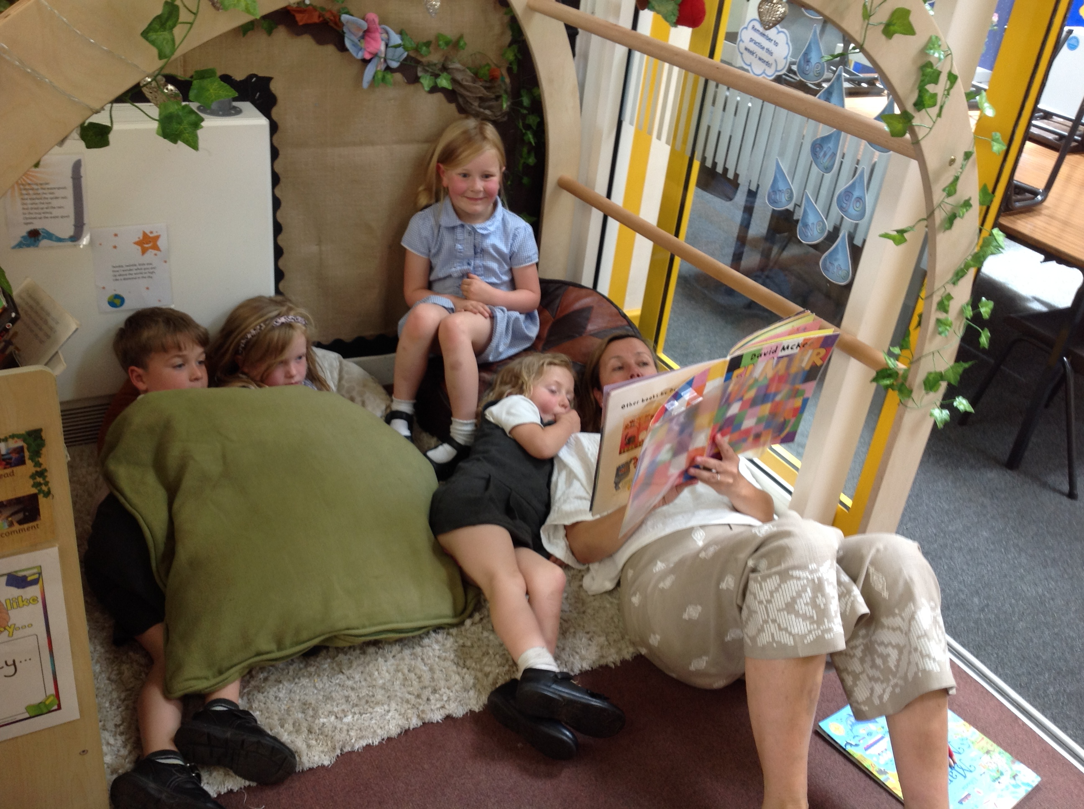
Reading
We want children
to love reading.
Learning to read should be
a positive experience.
Reading should be
enjoyable.
We want children to read
for pleasure and be life
long readers.
Reading underpins children’s access to the curriculum
and clearly impacts on their achievement.
Notes:
We all know how important learning to read is and the impact it has on a child’s success - it must be a positive experience
What’s the reality? Reluctant to read because they find it hard
Frustration stress tears –
Important to look at the big long term picture

Slide 13
How we teach reading
Reading practice sessions:
Built into phonics sessions once children are ready.
Taught by trained teacher or teaching assistant.
Taught in ability groups.
Ditty books are matched to children’s secure phonic knowledge and word reading. RWI offers comprehensive assessments which are carried out regularly.
We read home readers with children outside of their phonics sessions.
Books are sent home for reading practice – little and often.
Each book should be read three times.
Year 1 phonics screening includes ‘alien words’ so your child will be learning to read these too within their phonics sessions.
Notes:
Quite a big difference to how reading was previously taught

Slide 14
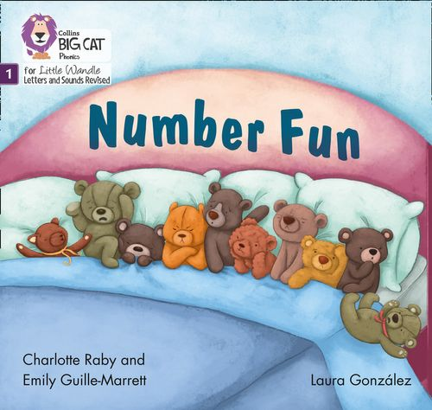
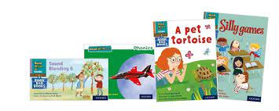
Home Readers
Once children have a secure knowledge of a number of
GPC’s (Grapheme Phoneme Correspondences)
and are confidently blending, they will be ready for
reading books.
Prior to this they will have wordless books which develop
great language skills and teach children the layout of books
and how to handle books.

Slide 15
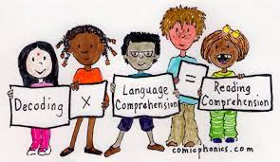
Reading practice books are carefully matched so children can read
fluently and independently
Decoding
Using intonation and expression
3. Comprehension
When children take their book home to read they should be 95% fluent.
Please do not worry that a book is too easy – your child needs to develop
fluency and confidence in reading. Re-reading a book they have had before
helps develop fluency – this is the goal. Your child’s phonic knowledge will be
slightly ahead of their reading level.

Slide 16
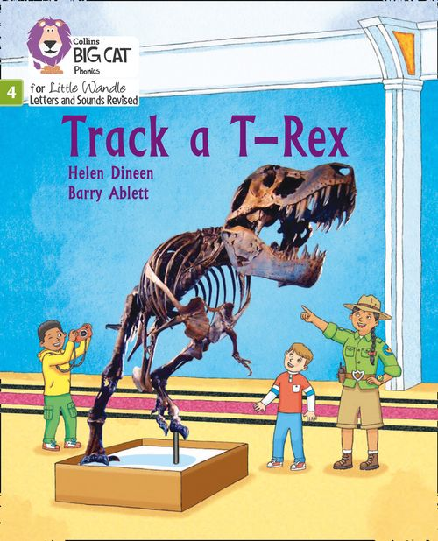
Sharing a book
Children will take their reading practice book home.
Share the front cover page, the blurb, ask what they think the book is about.
Celebrate, praise, talk about the book with you child.
You don’t have to read the whole book!
Please make sure books are in school bags everyday.
Please look after our books.
Celebrate success!
Notes:
Children will not be changing book multiple times a week as previously
Reading groups will be set up so you will be notified of when your book will be sent home/ need to be back in school
Groups will change!

Slide 17
What will they read after they have finished the phonics scheme?
Ideally children should complete the phonics scheme at the end of year 2.
Children will work their way through the RWI bands which finish at Grey and then they are able to start the Big Cat series.
They will still bring home a library book of choice also which they can share as read themselves as their reading improves.

Slide 18
Year 2 and beyond – The Big Cat Series…

Slide 19
What texts does Big Cat include and how is it progressive?
The Big Cat Scheme includes Fiction books (story), Non-Fiction (fact) and poetry.
It contains a variety of texts to offer a broad library of reading resources.
The children move through a progressive series of colours which become more difficult in lexis (language and vocabulary) as well as length of story.
Children choose their own books from the scheme at their ‘stage of develoment’.
An adult will regularly read with a child and will move them to the next stage when they feel they can decode (read) and shows appropriate comprehension ready for the subsequent band.

Slide 20
How can I help my child at home with reading (in Year 2 and beyond)?
Children smoothly move from learning to read to reading to learn.
Pick up on difficult vocabulary and explain it to the children. Make this into a game.
Take it in turns reading – model different voices and emotions to your child.
Questions, questions, questions! Who, what, where, when
Short bursts and keep it fun!

Slide 21
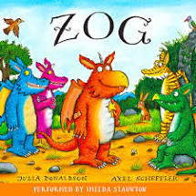
Supporting at home
Reading for pleasure books
Children will also bring home a ‘reading for pleasure book’ from our library each week.
To become lifelong readers, it is essential that they read for pleasure.
Children may not be able to read this book independently, but these books offer a wealth of opportunities for talking about the pictures and enjoying the story or information text.
Enjoy the book together and
foster a love of reading.

Slide 22
What else can parents do?
Please look at the RWI videos and guidance for parents.
Support children in learning the alphabetic code.
Let your child “show off” their reading to you and celebrate and praise all the way!
Share books with your children for pleasure.
Check on your class page for documents to support reading and phonics.

Slide 23
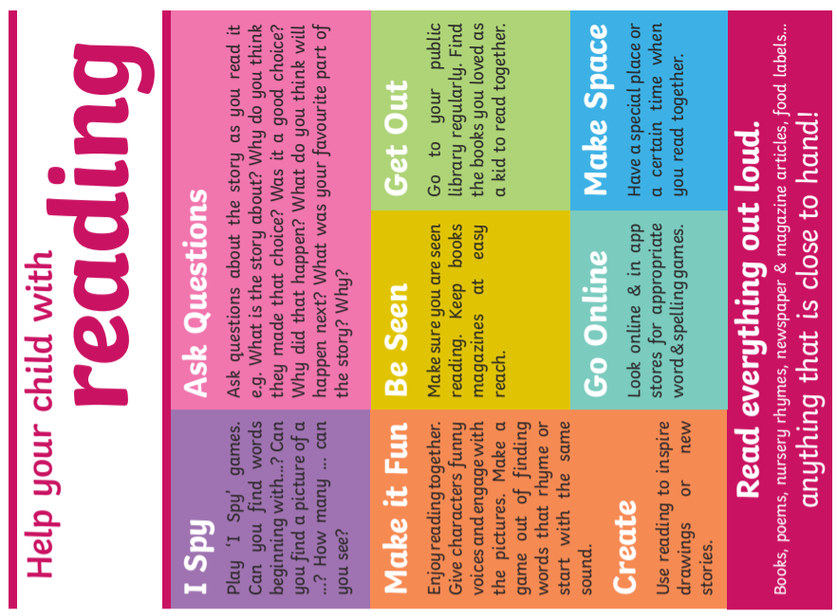

Slide 24
Thank you for joining us
Questions ???

