Slide 1
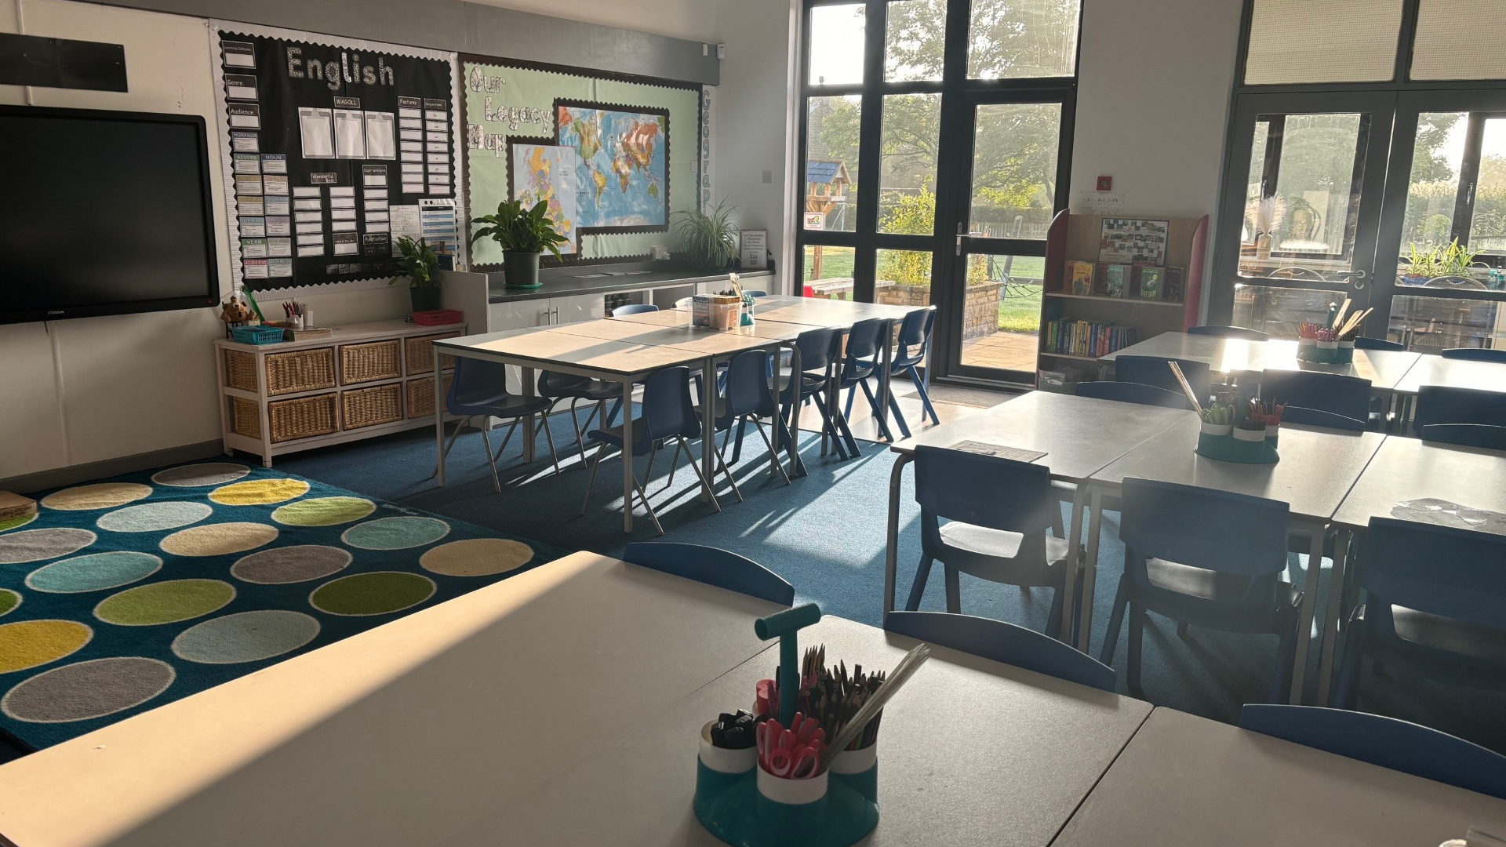
Welcome to Rhine Class

Slide 2
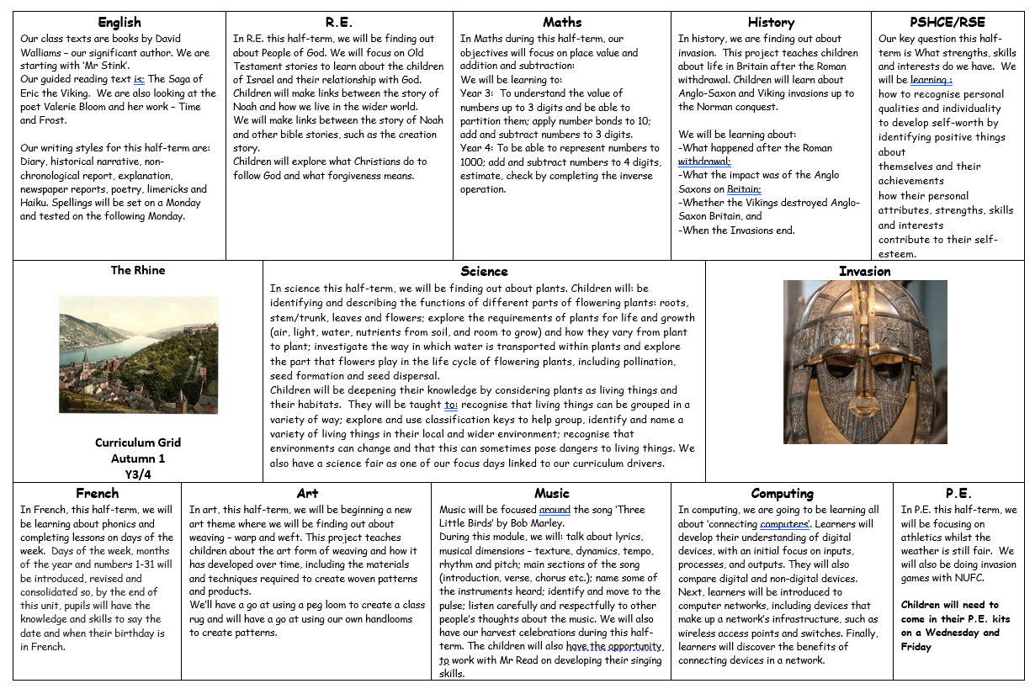
Rhine Class Curriculum Grid

Slide 3
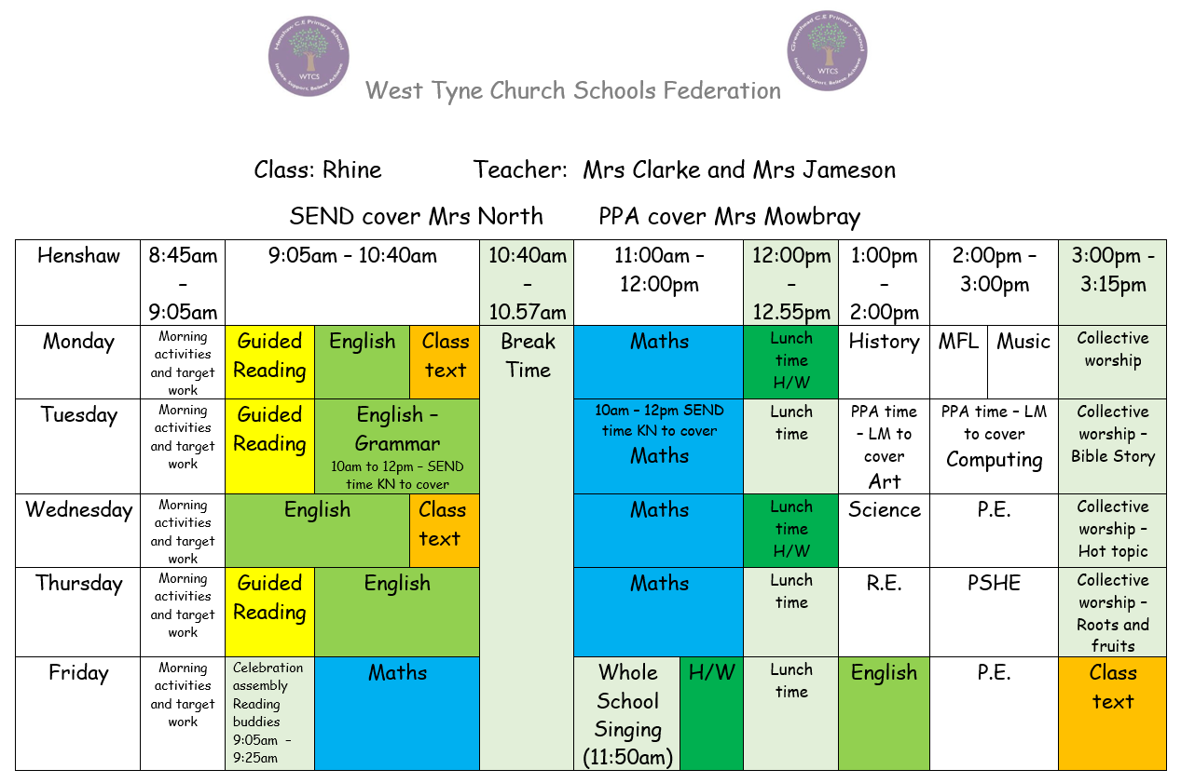
Rhine Class timetable

Slide 4
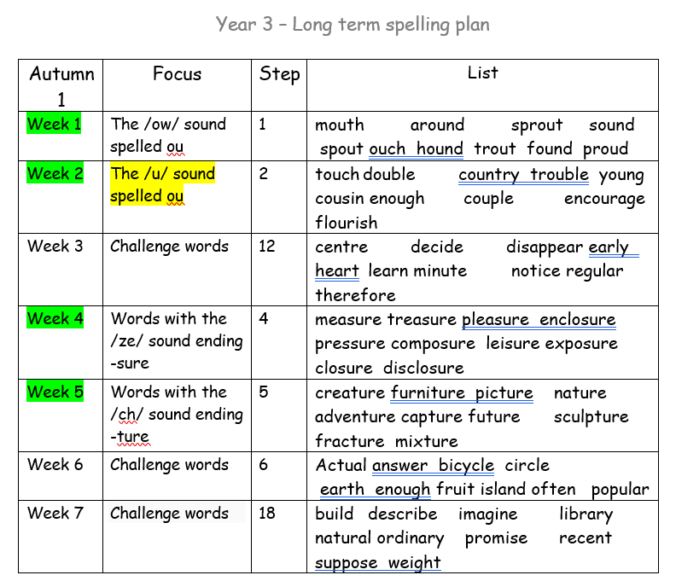
Spellings Year 3
http://www.henshaw.northumberland.sch.uk/web/lower_key_stage_2_curriculum_overview/292480

Slide 5
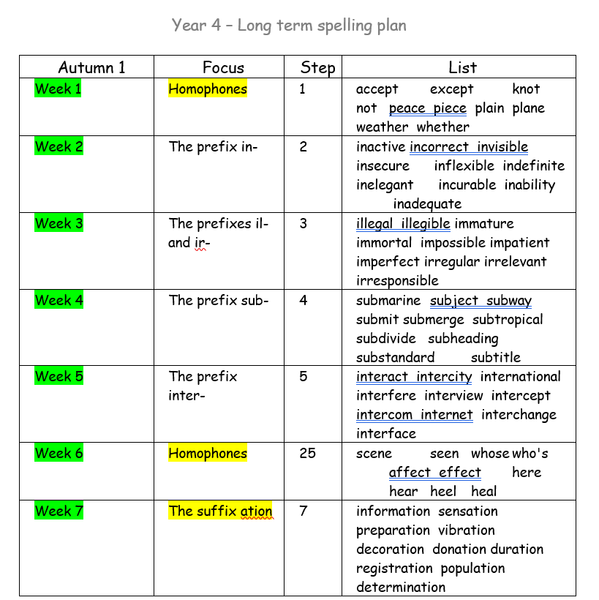
Spellings Year 4

Slide 6
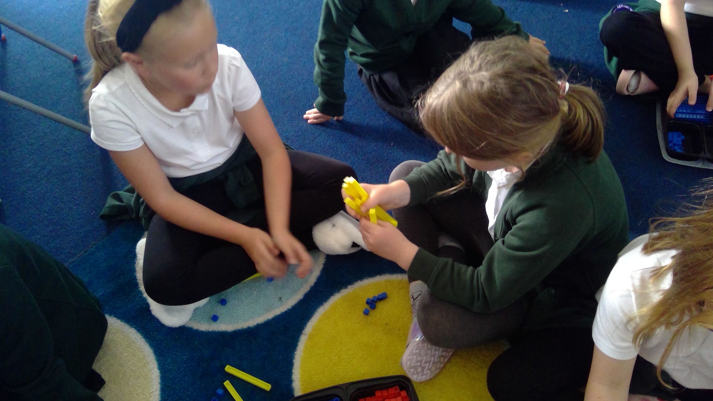
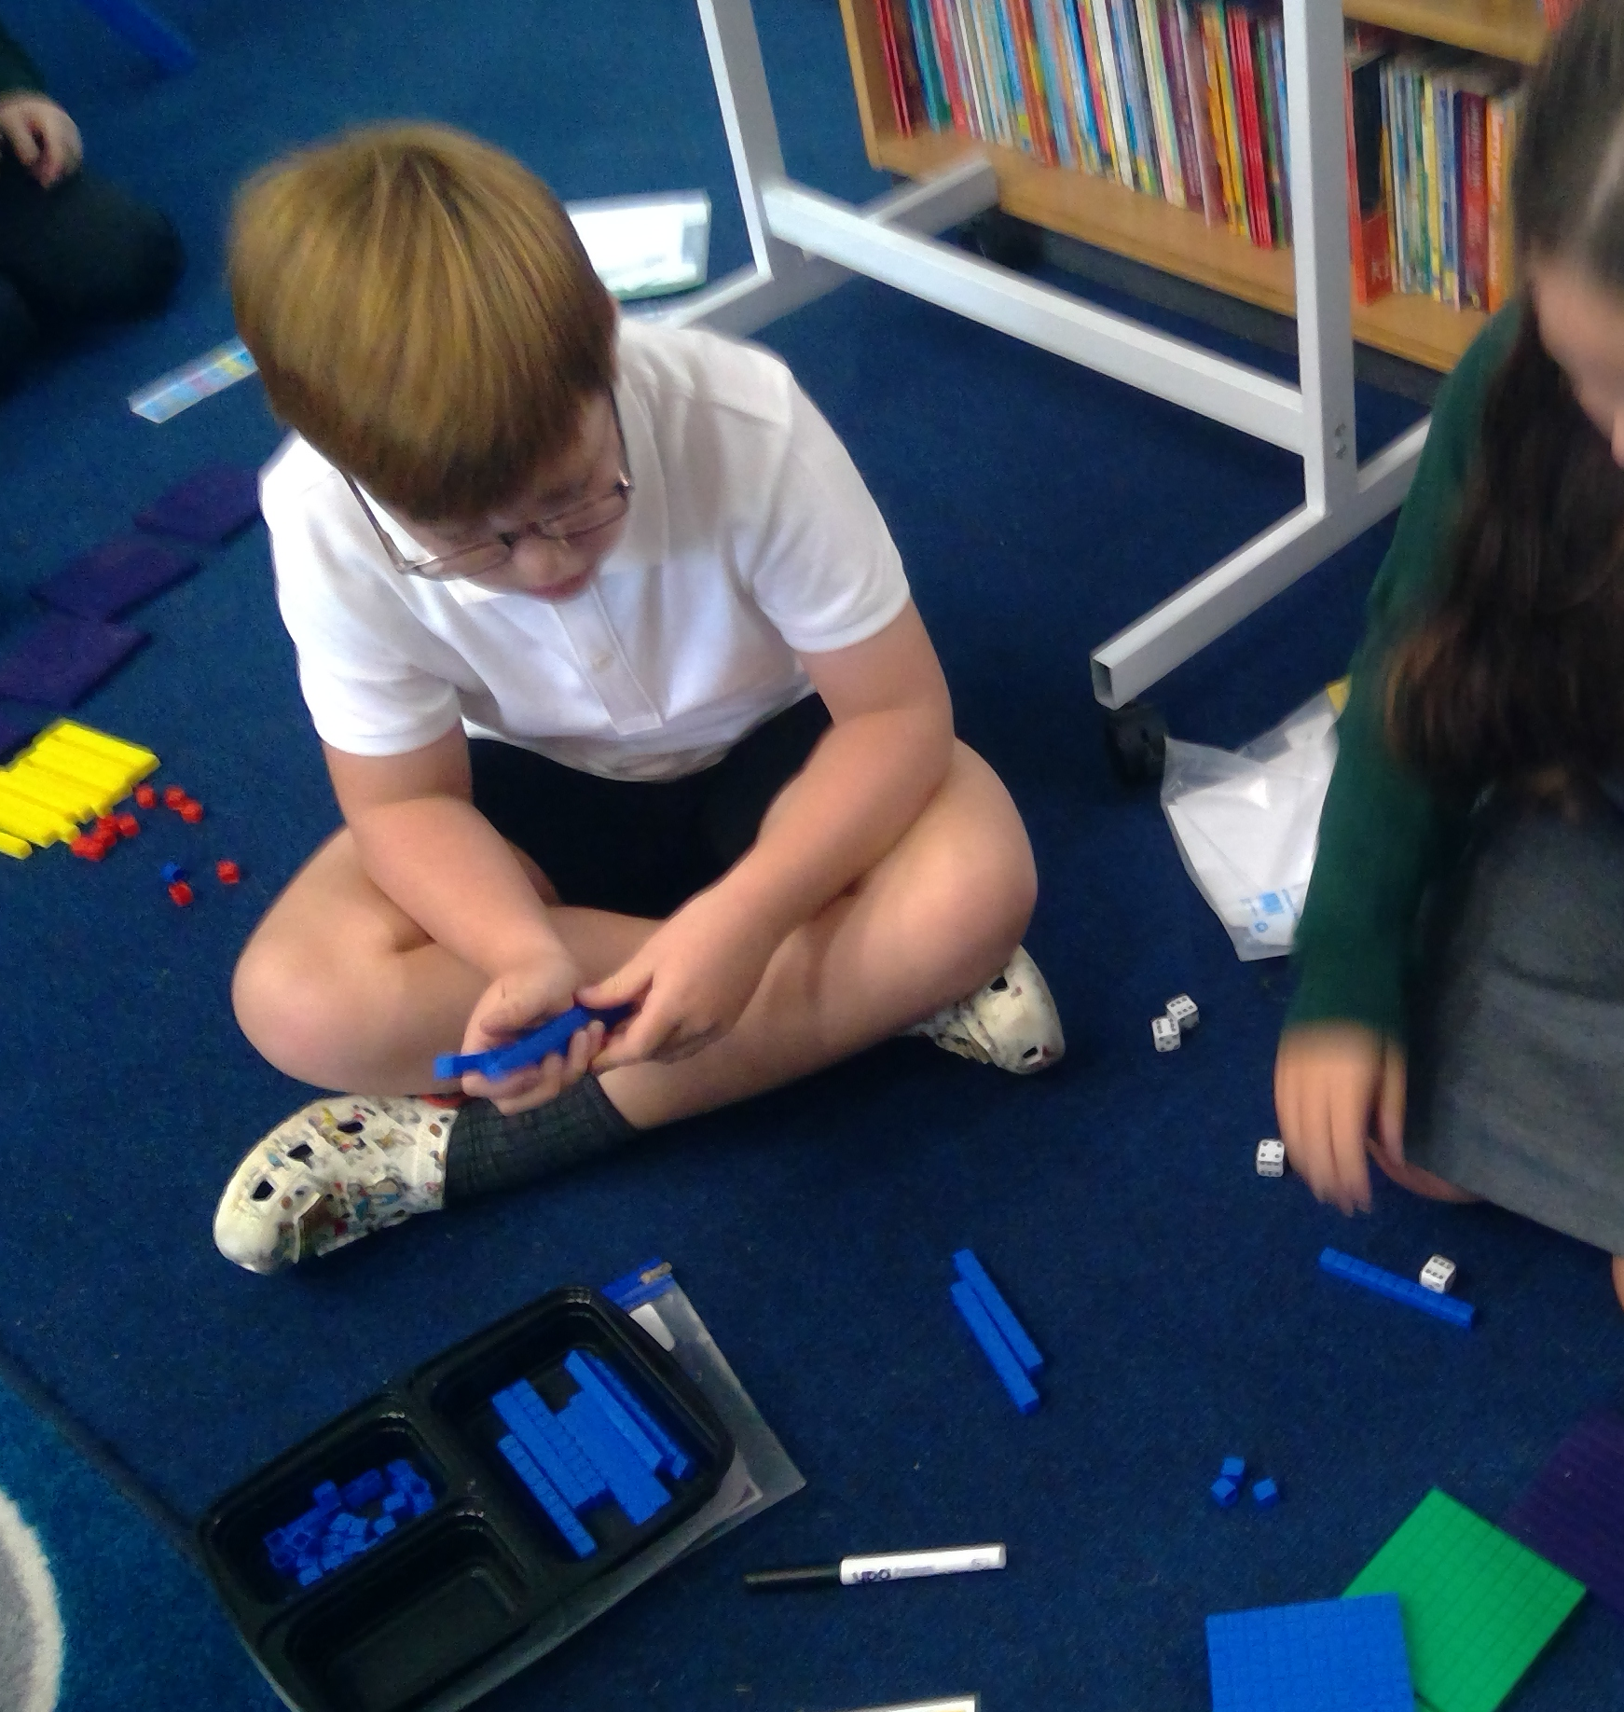
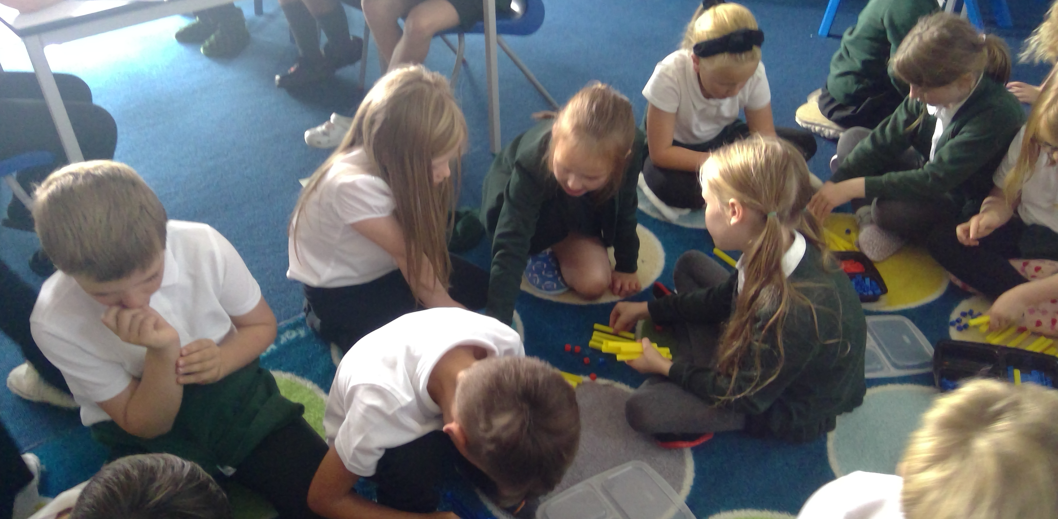
We will try to post at last one post on Facebook each week.

Slide 7
Any questions?
Ask any time in person – before and after school or via email: rhine@westtynefederation.uk

