Slide 1
Henshaw Primary School
Welcome

Slide 2
Mr Glenton
Introductions

Slide 3
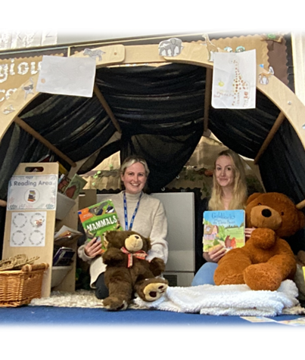
Mrs Alberts and Mrs Jamerson
Introductions
Notes:
NOTE: To change images on this slide, select a picture and delete it. Then click the Insert Picture icon in the placeholder to insert your own image.

Slide 4
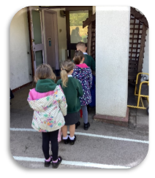
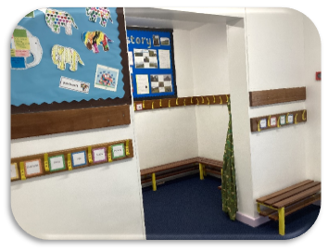
Reception – Start of the day
Notes:
NOTE: To change images on this slide, select a picture and delete it. Then click the Insert Picture icon in the placeholder to insert your own image.

Slide 5
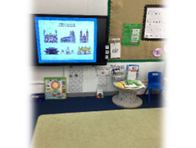
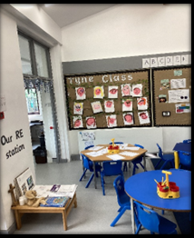
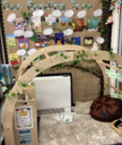
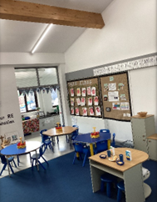
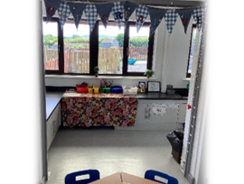
Classroom
Notes:
NOTE: To change images on this slide, select a picture and delete it. Then click the Insert Picture icon in the placeholder to insert your own image.

Slide 6
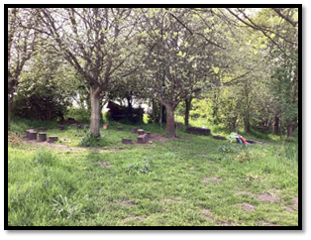
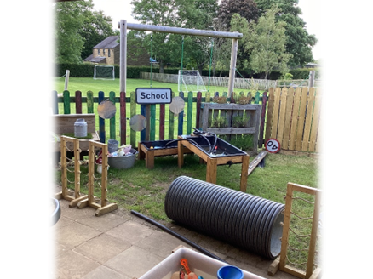
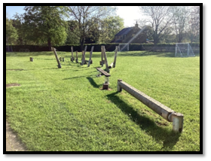
Outdoor learning
Notes:
NOTE: To change images on this slide, select a picture and delete it. Then click the Insert Picture icon in the placeholder to insert your own image.

Slide 7
Autumn 1 – All About Me
In Autumn 1 we start with ‘All about me!’
Children explore their own families and how families are all different.
We look at what makes us special with the help of Elmer the Elephant.
We learn about Autumn, celebrate harvest and join in our Harvest festival at our local church.

Slide 8
Phonics – Read Write Inc
Read Write Inc. is a government backed phonics teaching programme. The programme enables children to achieve high levels of reading success.
The children will start with wordless books and then move onto Dittys. The children will then progress onto different coloured books based on their phonics sound knowledge.
Each child is carefully assessed and placed into a RWI group based on their phonics sound knowledge and reading skills. This ensures that all children are working at the right level for their ability which is the best way to ensure progress and confidence in their reading skills.
The children will receive a library book once a week to read at home. This is a book of the child’s choice and helps to continue a love of reading.

Slide 9
Information
School uniform
Holidays
Pupil Premium
Packed Lunch policy
Contacts

